Slide 1
Group Project Mid Semester Presentation
Group 19
Dongge, Xi, Luan, Tenzin

Slide 2
Outline
Project Overview
Project Plan
Project Progress
Future Activities
Risks, Issues & Impediments

Slide 3
Project Overview
Website on ‘Five Places of Interest in Canberra’
To serve as information site for tourists
Tourists can find information on places that covers many aspects of Canberra:
History
Nature and Wildlife
Politics
Documentation on deploying website

Slide 4
Project Overview
Scope & Success Criteria:
A brief description
Location using google maps
Link to their website
Picture Gallery
Ability to post and view comments
Website hosted/deployed on a public server
Documentation about deployment

Slide 5
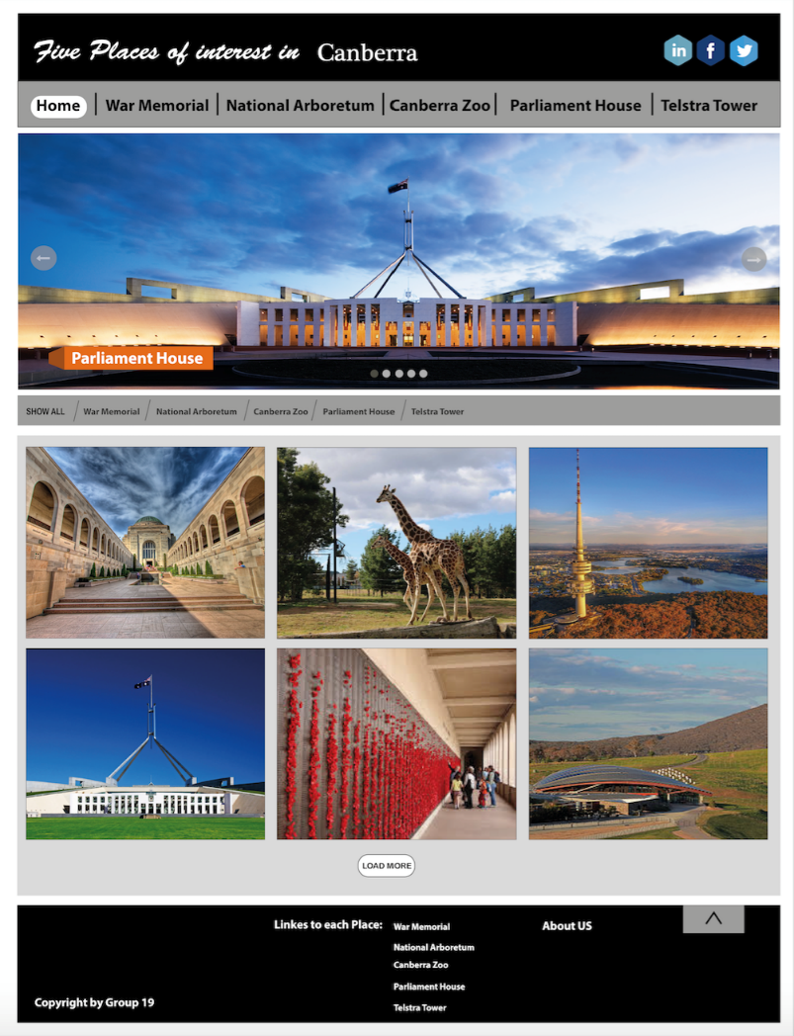
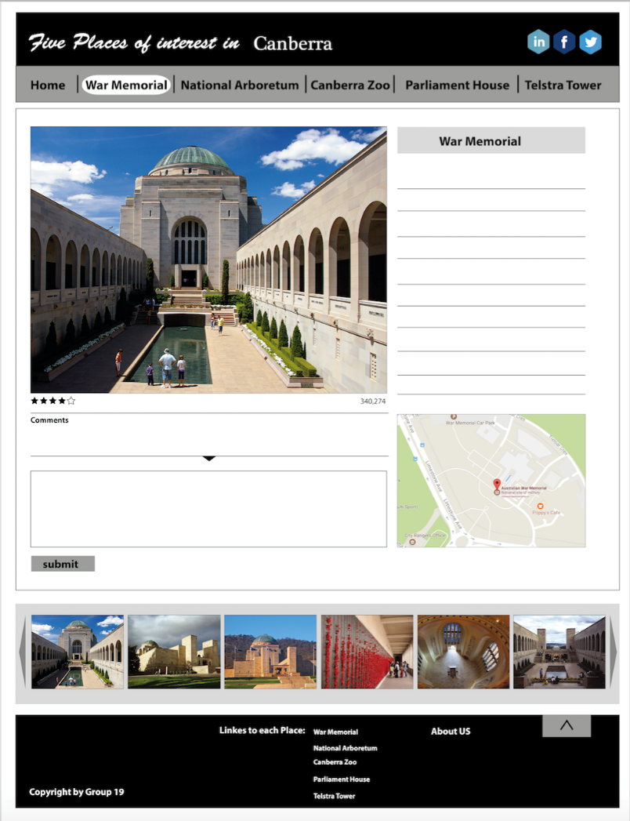
Project Overview
Prototype Pages

Slide 6
Project Overview
Technology
.NET core web application in Visual Studio
MSsql Database
Hosted on Amazon Web Services (AWS)
Configuration Management
No version control – group members have minimal experience
Instead we take backup of working snapshots weekly
Using UC’s Office 365 to share & edit documents like this presentation slide, reports..
Change Management – Using a shared document to log changes and decisions taken during group meeting

Slide 7
Project Plan - Change from Initial Plan
From ‘Restaurants’ to ‘Five Places of Interest in Canberra’
Additional scope:
User comments on webpages – To make the website more informative and create more content
Deployment of website on a server

Slide 8
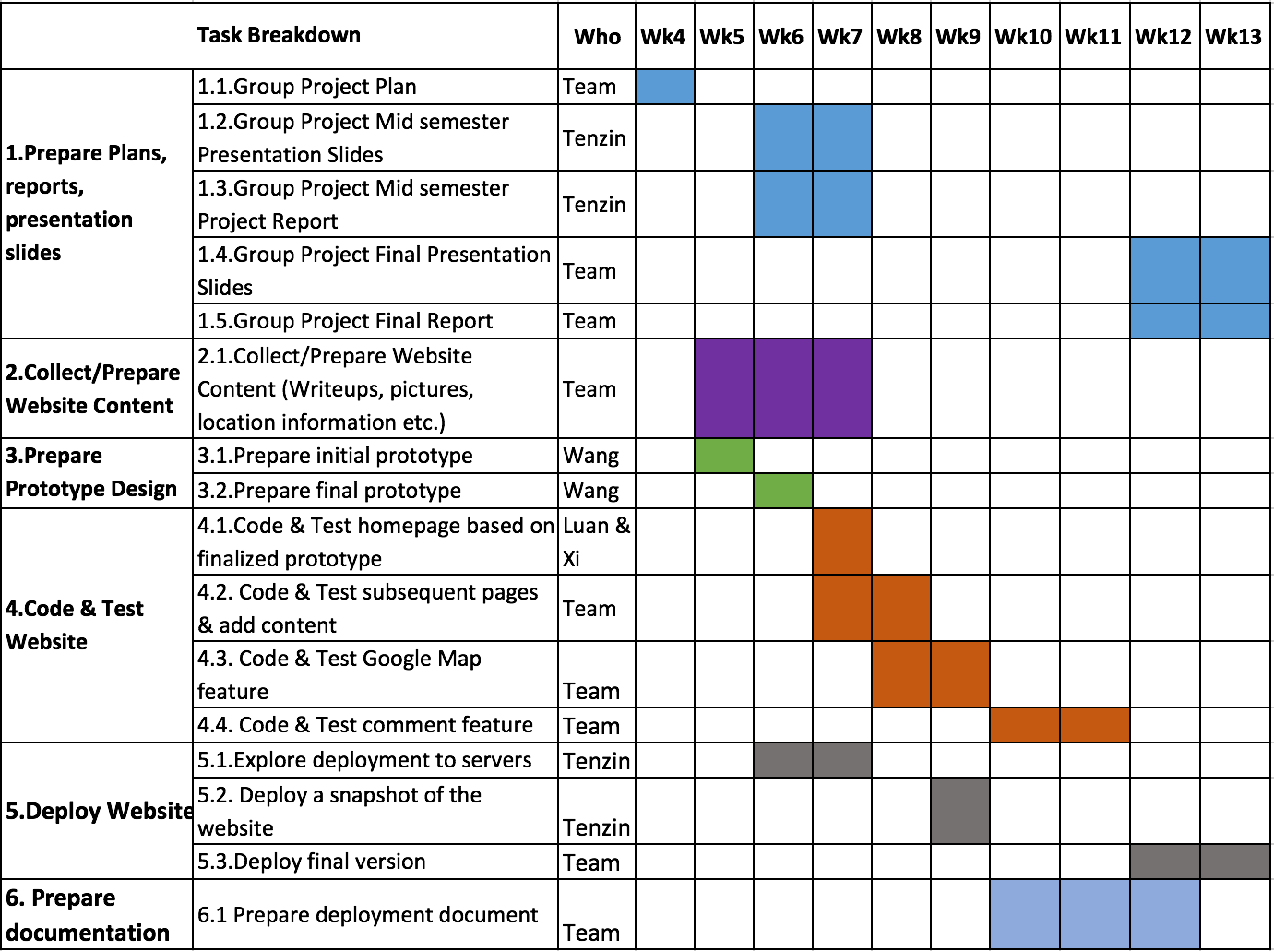
Project Plan - Schedule & Task Breakdown

Slide 9
Project Progress
Reworked on Initial Plan
Initial design/prototype of website
Started coding the homepage prototype
Created free AWS Educate account – Planning to use an AWS instance as deployment server

Slide 10
Future Activities
Code the website incrementally – adding features and testing
Backup copies of working snapshot after each increment - backups to be kept with each group member
Explore techniques to implement features like google maps and comments
Test deployment of a working increment to AWS

Slide 11
Risks, Issues & Impediments
Timing for group meeting, group work
Meet on weekends, use group Instant Messaging for communication
Deployment to server may not work
Change scope?
May not get pictures with appropriate license
Groups members to visit the places and take pictures
Accidental loss of project work
Making regular backup
Group member going abroad for emergency
Use our communication channel

Slide 12
Reference of pictures used to create prototype
http://www.canberraentrepreneur.com/wp-content/uploads/2014/11/Parliament_House_Canberra_NS.jpg
http://www.grayline.com.au/images/sydney/canberra/parliament-house-canberra-australia-1024x768.jpg
http://www.dronestagr.am/wp-content/uploads/2017/01/FullSizeRender-6-1200x800.jpg
http://www.abc.net.au/news/image/8555530-3x2-940x627.jpg
https://upload.wikimedia.org/wikipedia/commons/thumb/9/9d/Canberra_National_Arboretum_with_Telstra_Tower%2C_Canberra_ACT.JPG/400px-Canberra_National_Arboretum_with_Telstra_Tower%2C_Canberra_ACT.JPG
http://d3lp4xedbqa8a5.cloudfront.net/s3/digital-cougar-assets/AusGeo/2014/01/22/37197/800px-Parliament_House_Canberra_Dusk_Panorama.jpg

Slide 13
Thank You

